Slide 1
VideoGen

Slide 2
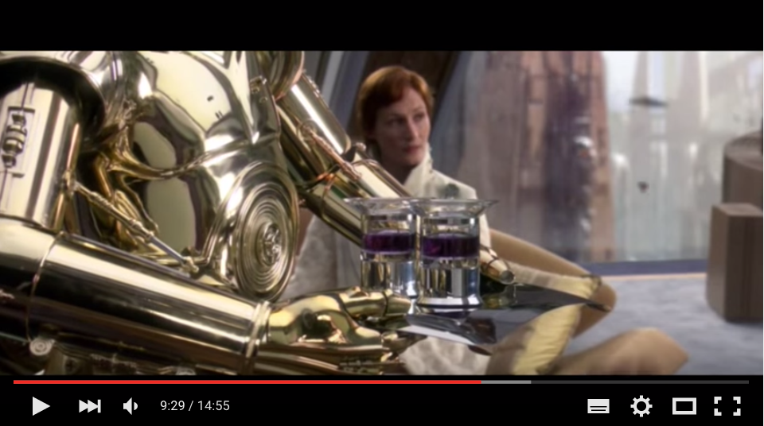
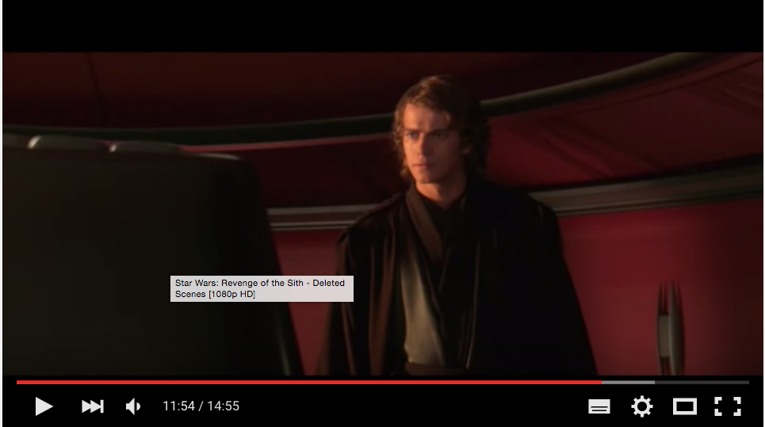
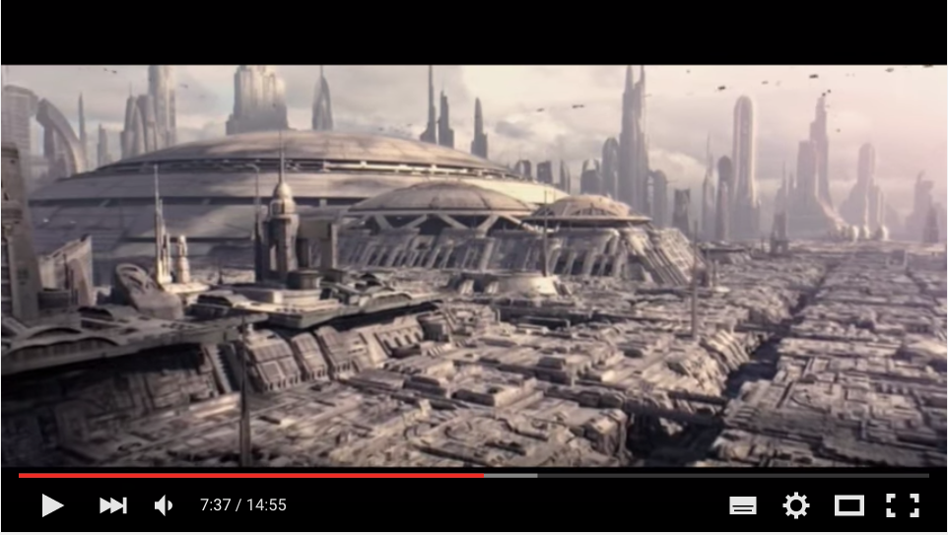
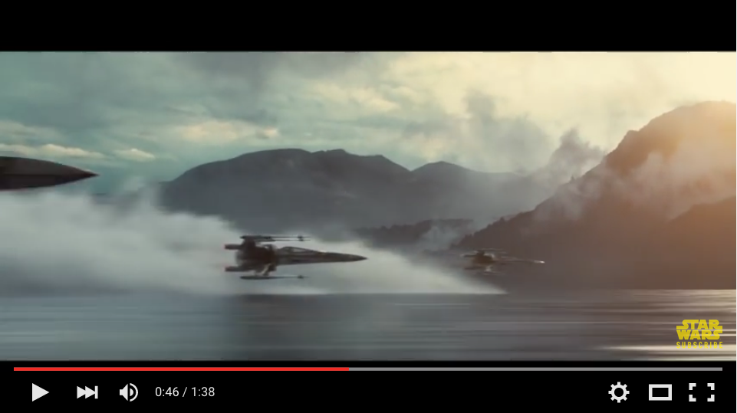
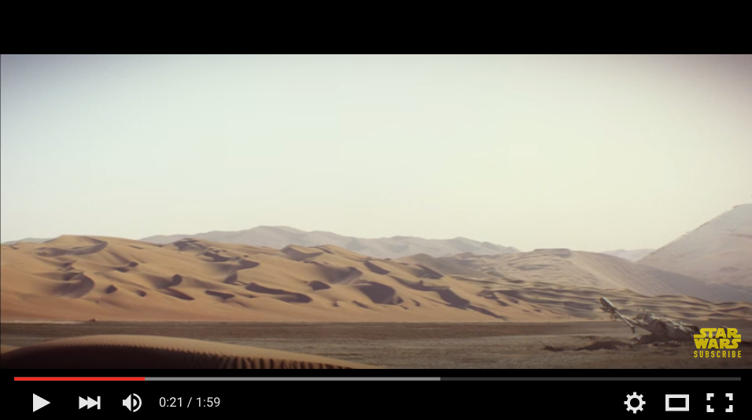
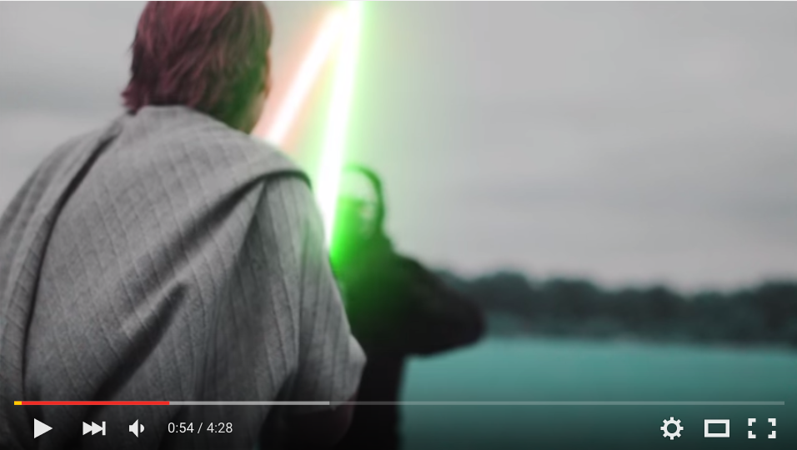
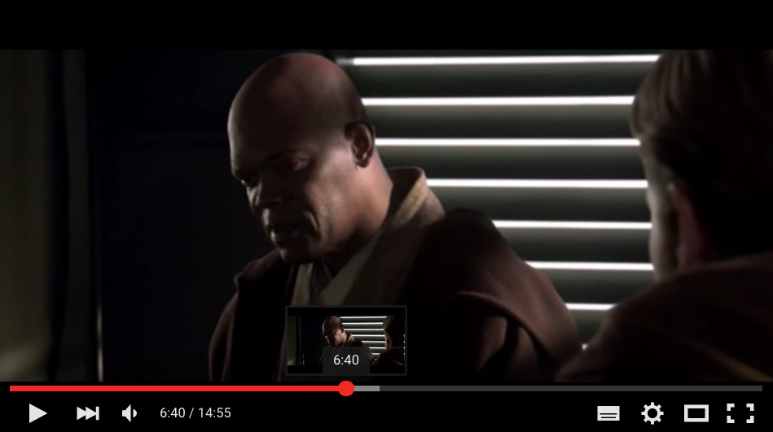
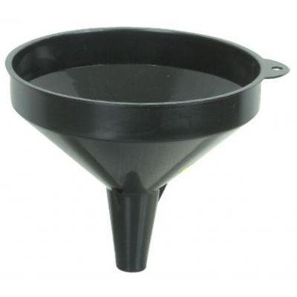
Generator
~ composition of video sequences
video variants

Slide 3
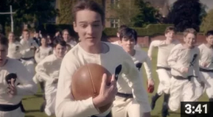
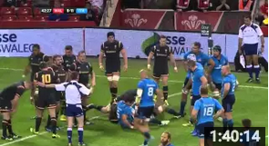
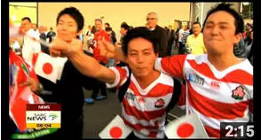
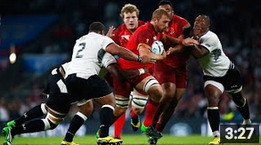
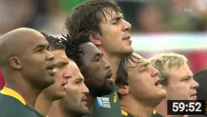

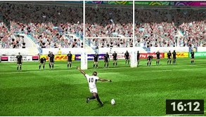
Generator
~ composition of video sequences
video variants

Slide 4
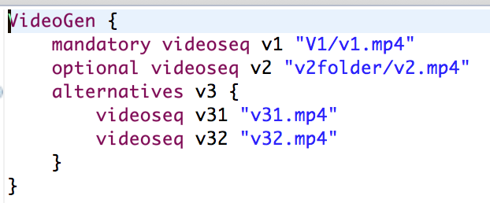
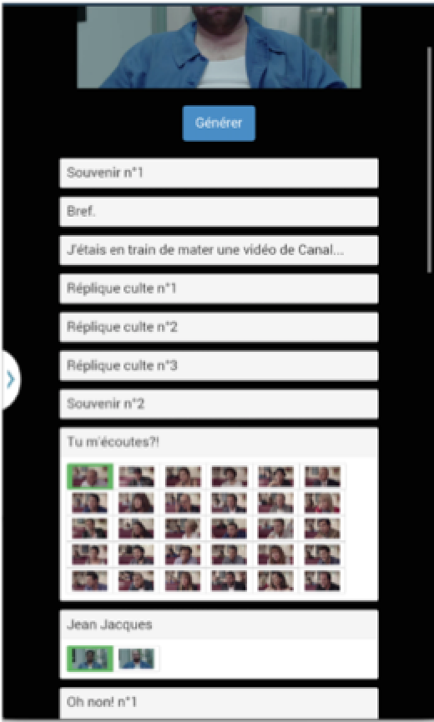
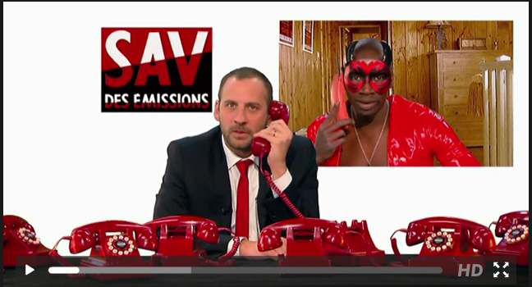
Website/online
Random generation
Configurator
Game
…

Slide 5







Slide 6
#1 How to design, create, and support dedicated languages (DSLs)?
#2 How to transform models/programs?
#3 How to manage variability/variants?
#4 How do frameworks internally work?

Slide 7

Interpretation
--
calling VLC for each videoseq

Slide 8
model-to-text
# this is a comment
file ‘V1/v1.mp4'
file ‘v2folder/v2.mp4'
file ’v32.mp4'

Slide 9
model-to-text
V1/v1.mp4
v2folder/v2.mp4
v32.mp4
.m3u

Slide 10

model-to-text
#EXTM3U
#EXT-X-DISCONTINUITY
#EXTINF:3
resources/videos/vp0-logo/logo_start.ts
#EXT-X-DISCONTINUITY
#EXTINF:12
resources/videos/vp1-QR/QR05_1.ts
#EXT-X-DISCONTINUITY
#EXTINF:2
resources/videos/vp2-intro-fluide-glacial/EtPendantCeTempsLaEn1975_processed.ts
.m3u (extended)

Slide 11
model-to-model
playlist
metamodel
playlist model
model-to-text

Slide 12
model-to-*
Thumbnails (vignettes) of each video sequence (e.g., PGN format)

Slide 13
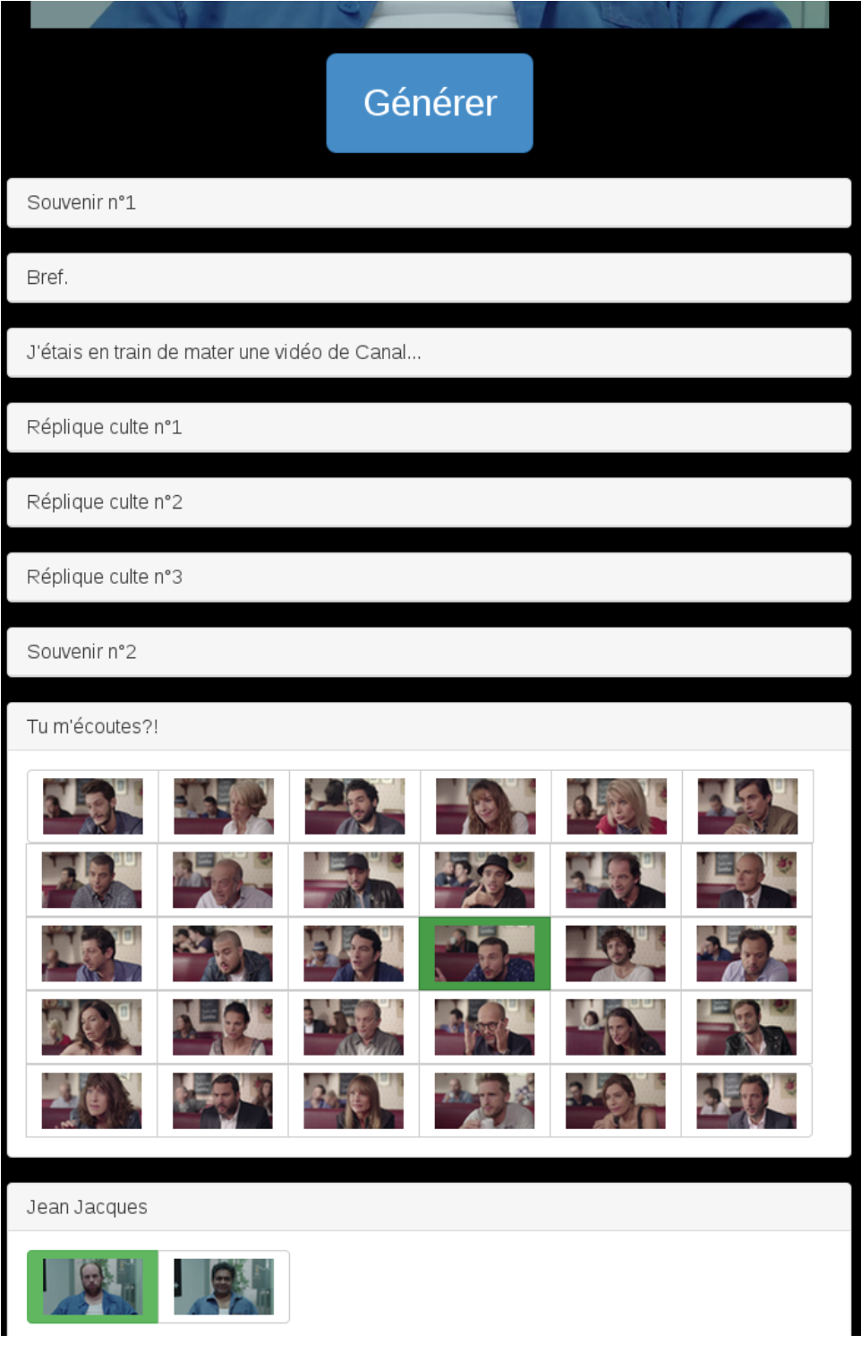
model-to-*
Thumbnails (vignettes) of each video sequence (e.g., PGN format)

Slide 14
model-to-*
Thumbnails (vignettes) of each video sequence (e.g., PGN format)

Slide 15
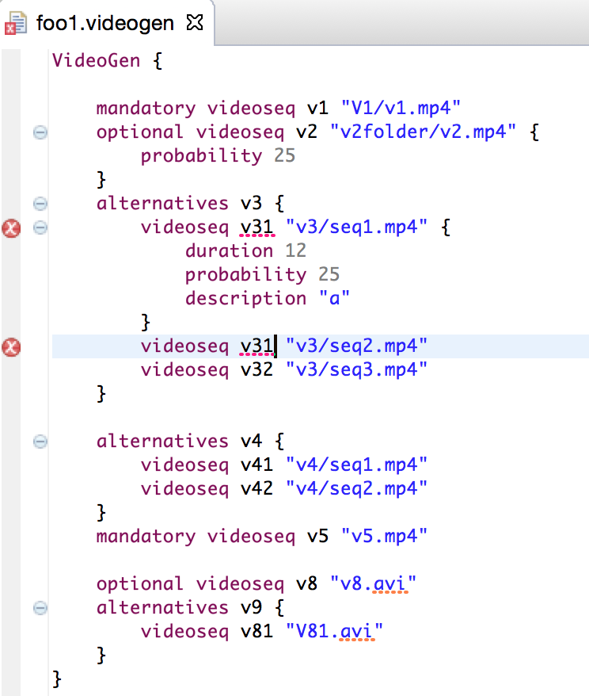


Slide 16
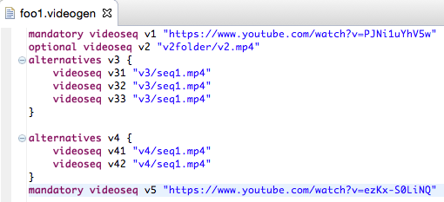

18, 167, 899

Slide 17
Website/online
Random generation
Configurator
Game
…

Slide 18
Feature model: another model
for modeling “features” of your
Web site (eg ability to save the
video; mode=generation
with frequencies)
Website/online
Random generation
Configurator
Game
…

Slide 19

model-to-text
fmVideoGen = FM (VideoGen: v1 [v2] v3; v3: (v31|v32); )

